Slide 1
Image and Video Processing Lab
Mini Project - JPEG Compression
Submitted by:
Sneha Dash, 21EC39023
Unnati Singh, 21EC39027

Slide 2
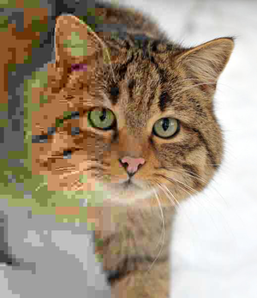
JPEG
JPEG (Joint Photographic Experts Group) is a widely used compression standard, especially for photographic images, developed in the late 1980s.
It’s optimized for compressing images with complex color gradients and high detail, where preserving visual quality is essential.
JPEG uses lossy compression to reduce file sizes, making it easier to store and share images without significantly compromising visual quality.
A photo of a European wildcat with the compression rate, and associated losses, decreasing from left to right

Slide 3
JPEG Compression Pipeline
Color Space Conversion
Downsampling and Block Formation
Discrete Cosine Transform
Images are converted from the RGB colour space to the YCbCr colour space.
Quantization
Run Length Encoding
For every 4x4 block of Y samples, there is a 2x2 block for Cb and Cr. JPEG divides each channel (Y, Cb, Cr) into 8x8 pixel blocks.
Low-frequency components, are concentrated in the upper-left corner of the DCT matrix, while high-frequency components are spread toward the lower-right.
Huffman Encoding
The DCT coefficients are divided by a quantization matrix and then rounded to reduce precision
RLE is used to compress repeated zero values, after zigzag ordering
Variable-length encoding technique that assigns shorter codes to frequently occurring symbols and longer codes to less frequent ones
1
2
3
4
5
6

Slide 4
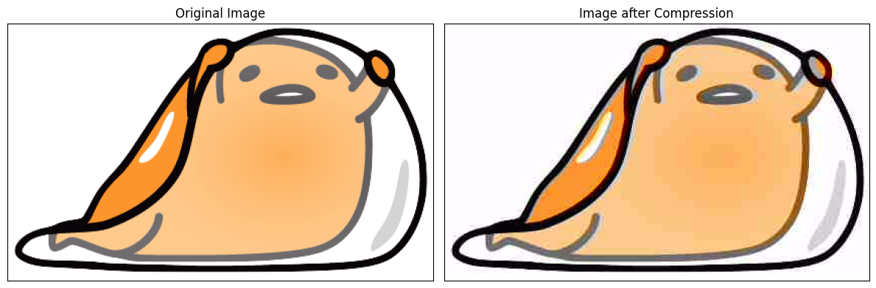

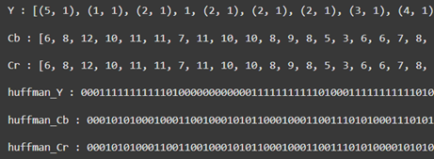
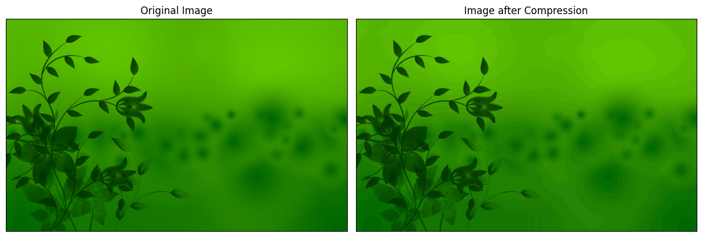

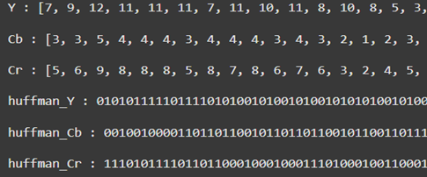
Results

Slide 5
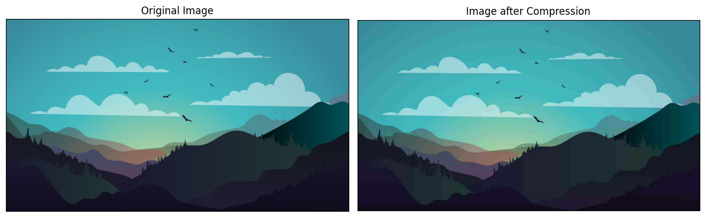

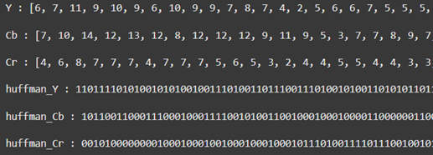
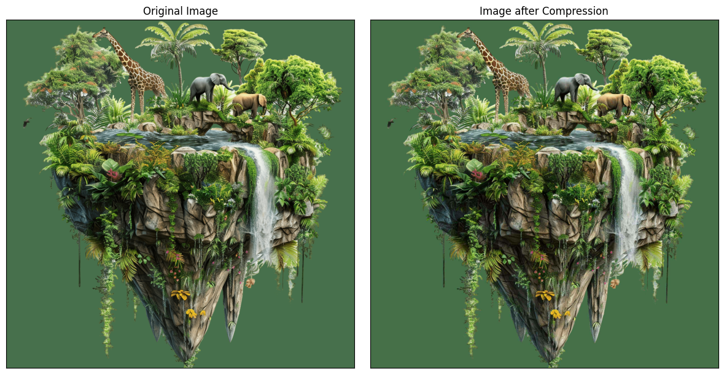
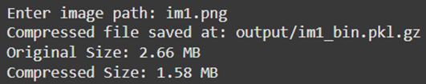
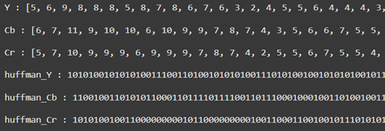
Results

Slide 6
Conclusion
Efficient Compression
JPEG Compression
Loss of Image Data
Adaptability

